Slide 1

Predictive Analytics of Productivity Prediction of Garment Employees
Professor: Ceni Babaoglu
Student Name: Maryam Mortezapourdehkordi
Student Number: 501143277
Date of submission: Dec 5, 2022

Slide 2
Introduction
Productivity of the Garment industry is very Important:
Garment industry has significantly affected contemporary society.
The vast number of labour and manual procedures and requires much effort
Mainly responsible for meeting the enormous worldwide demand for clothing items.
The profit margin of a business rises with the increase in productivity. When output levels increase, clothing production costs decrease.
The staff’s high level of productivity is of paramount importance.

Slide 3
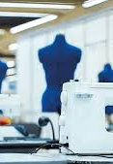
Goal and Questions
We are curious about the following questions:
what factors may impact employee productivity or lead to increased productivity?
How can work efficiency be predicted in a corporation given specific factors?
Has time affected the efficiency or productivity of employees?

Slide 4
Goal and Questions
Build models to classify and predict the productivity of garment employees for the dataset.
Compare the performance of Regression Models (Linear, Lasso, Ridge, Poisson, decision tree, KNN regression, SVR, Random Forest) and boosting algorithms (xgboost, Gradient boosting).

Slide 5
Literature review
Result some study shows in predicting employee productivity which is one of the most substantial factors in any organization. After applying classification algorithms, we obtained a Random forest has minimal values of the correlation coefficient, MAE, and RMSE, which reflect that RF is very appropriate in predicting employee productivity.
Some results demonstrated that the gradient-boosted decision trees were the best through all the decision-tree-based methods.
Four different ML algorithms, including support vector machine, optimized support vector machine (using a genetic algorithm), random forest, XGBoost and Deep Learning, For predicting the overall equipment effectiveness (OEE), which is a performance measurement of the manufacturing industry.
Deep learning and random forest with cross-validation manifest the best results for predicting OEE.
Another Study that was released focused on predicting garment employee productivity using different machine learning algorithms such as J48, RF, SVM, NB, and RBF with and without ensemble learning algorithms, including bagging and Adaboost. The best results were obtained by J48 combined with Adaboost on 20th iterations with 0.9916 accuracies, 0.0083 MAE and 0.0908 RSME. Consequently, J48 with the Adaboost algorithm was found to be the best for garment employee productivity prediction.

Slide 6

Dataset
Dataset experts and published in the UC Irvine Machine Learning Repository. Dataset has 15 features for 1197 instances.
Eleven features are numerical
four features are categorical.
The dependent variable is Actual Productivity, which shows The actual % of productivity that was delivered by the workers.
It ranges from 0-1.
team
targeted_productivity
smv
wip
over_time
incentive
idle_time
idle_men
no_of_style_change
no_of_workers
actual_productivity
Numerical
quarter
department
day
team
no_of_style_change
Categorical

Slide 7
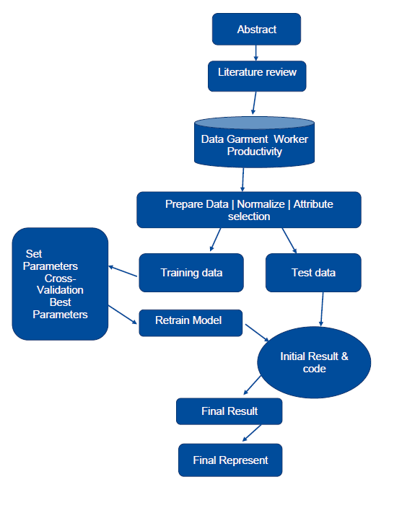
Methodology

Slide 8

Steps to implement
Collecting data
Cleaning data
Missing data
Labelling raw data
Visualizing the data.
Encoding and Scaling
Data Processing
Cross-validation for split data to train and test
Recursive feature elimination (RFE) for feature selection
Creating an estimator, Creating an RFE object
fitting the training data into our model are all steps that I applied for feature selection,
prepared data for data modelling
Feature selecting
December 6, 2022 |
8

Slide 9
Steps to implement
Linear Regression
Lasso Regression
Ridge Regression
Decision Trees
Random Forest
Support Vector Regression,
Kneighbour Regression
XGBoost,
Gradient Boost.
•Model Development
December 6, 2022 |
9

Slide 10
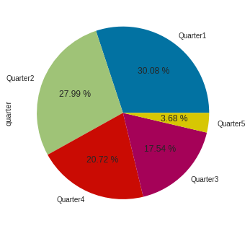
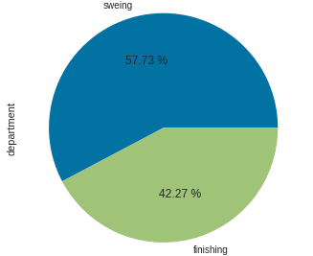
Pie chart for understanding Categorical feature:
Department
Quarter

Slide 11
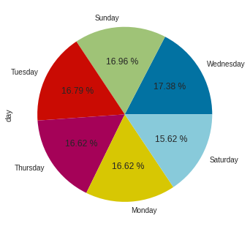
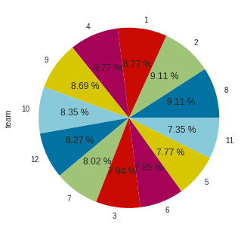
Pie chart for understanding Categorical feature:
Day
Team

Slide 12
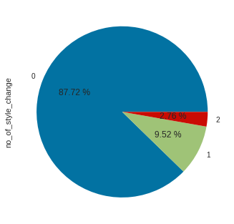
Pie chart for understanding Categorical feature:
No-of-work

Slide 13
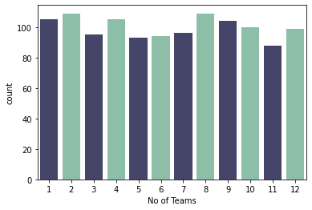
Bar chart for understanding Numerical feature:
Team: There are 12 teams. Because It is highly desirable among the decision-makers in the garments industry to track, analyze and predict the productivity performance of the working teams in their factories, my analysis will be on team basis

Slide 14
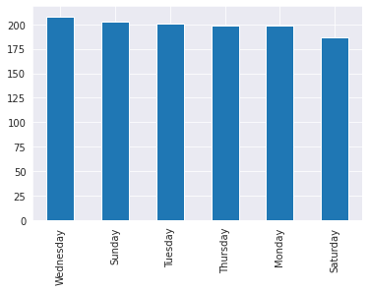
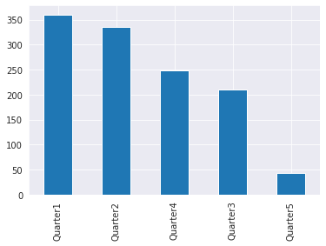
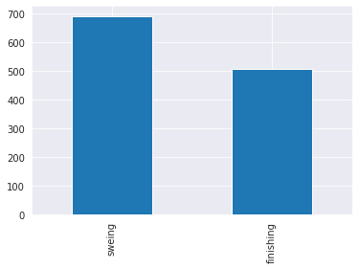
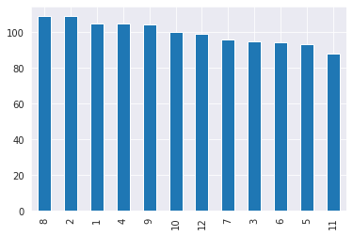
Day
Quarter
Department
Team

Slide 15
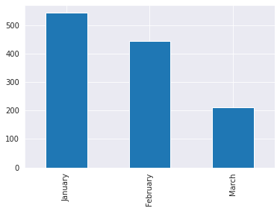
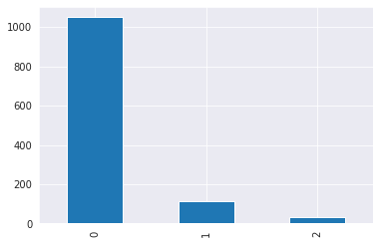
Month
No-of-style-change

Slide 16
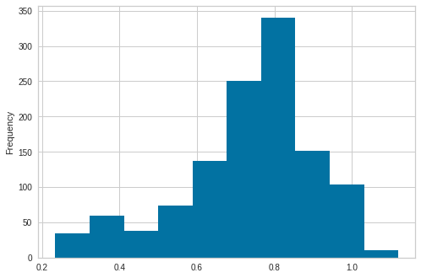
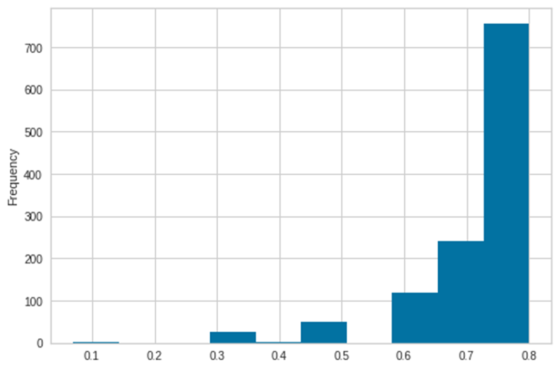
Numerical feature:
Actual productivity
targeted_productivity

Slide 17
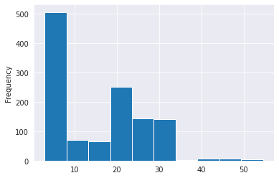
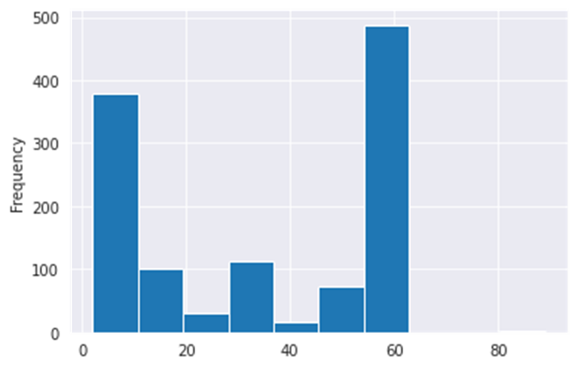
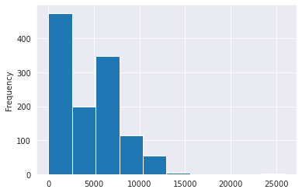
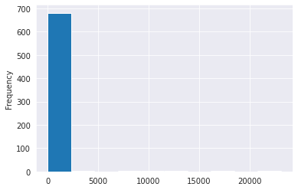


Numerical feature:
SMV
no_of_workers
Over_time
wip
incentive
idle_men

Slide 18
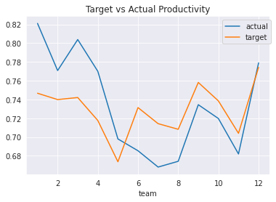
Time series chart :
Actual prodactivity

Slide 19
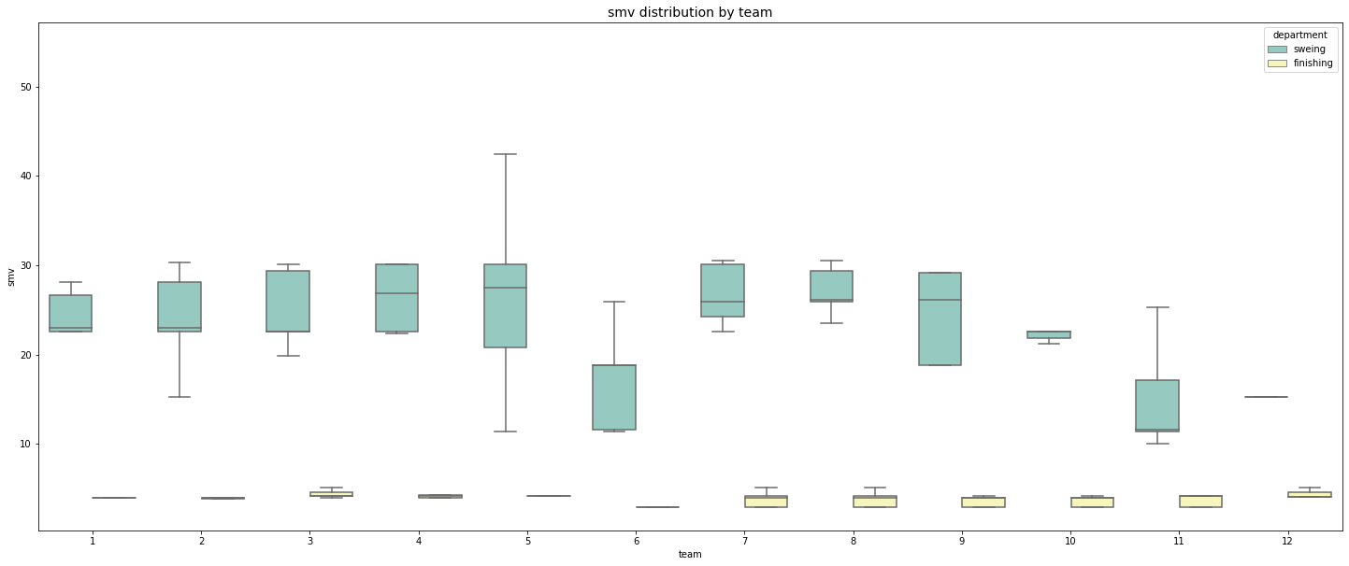
Bar chart for understanding Numerical feature:
When we look into the smv boxplot on team basis with department separation, it can be clearly seen that while there are fluctuations between teams in the sewing department, the finishing department has almost evenly distributed smv values for each team.

Slide 20
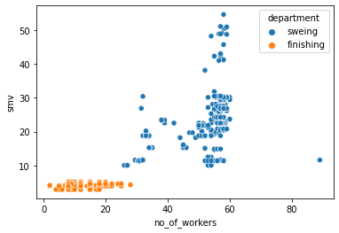
Bar chart for understanding Numerical feature:
For the finishing department SMV does not change with no_of_workers

Slide 21
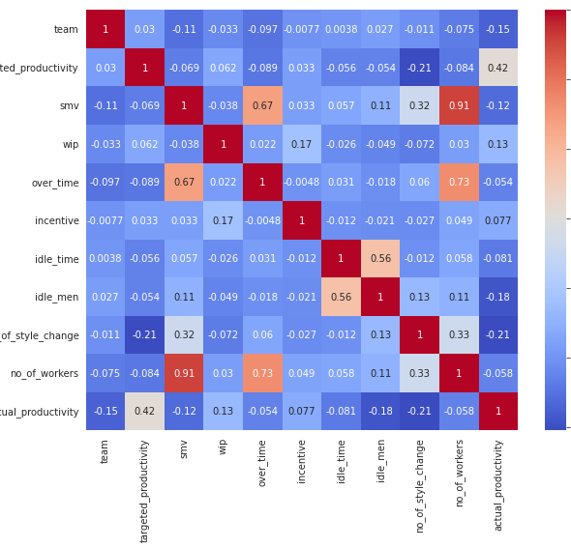
Correlation
Highest Positive Correlations:
No_of workers and smv (0.91)
No_of workers and over_time (0.73)
Over_time and smv (0.67)
Idle_men and Idle_time (0.56)
Positive Correlations:
No_of workers and no_of_style_change(0.33)
No_of_style_changehas and smv (0.32)

Slide 22
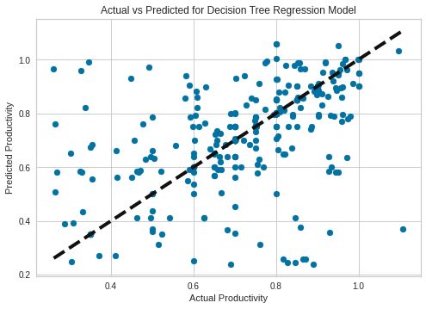
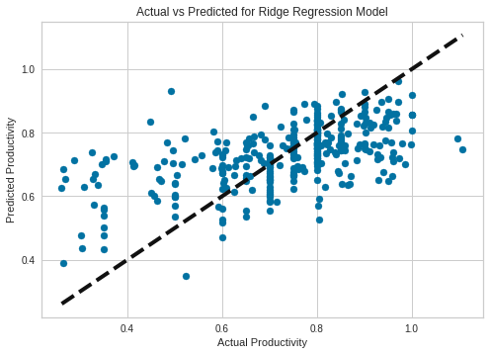

Slide 23
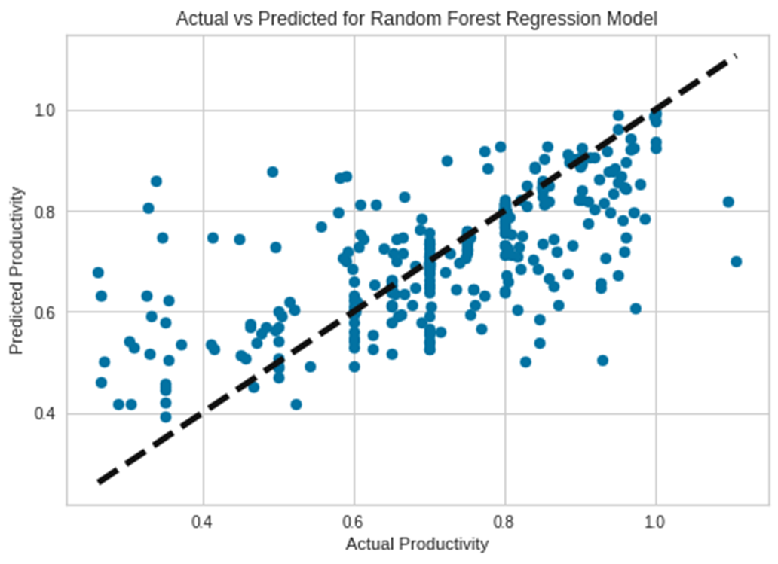
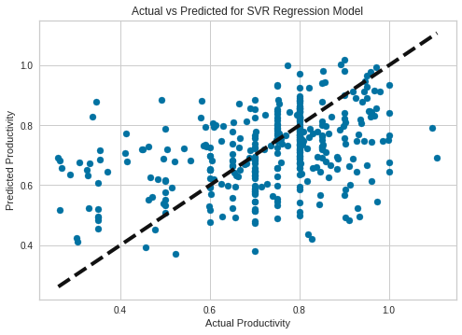

Slide 24
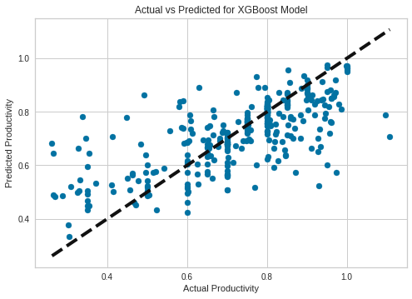
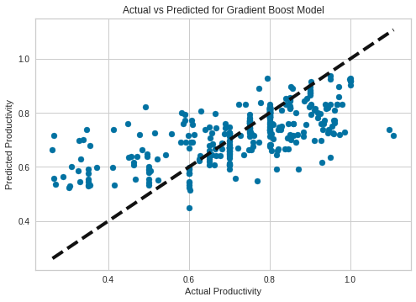

Slide 25
Result
All the methods had good metrics for classification and prediction.
Random forest, Xboost and Gradient Boost had the highest accuracy.
targerted_productivity can have a strong positive impact on actual_productivity.
Quarter is another factor influencing actual productivity, with Quarters 5, 1, and 2 being the most productive, respectively.
Team can also affect actual productivity, with teams 1, 12, and 3 being the most productive, respectively.
no_of_workers can also play a role in influencing actual_productivity
Incentive is also another important factor that can be a meaningful predictor of actual_productivity.
understand that date and time features have the least impact on productivity.
December 6, 2022 |
25

Slide 26
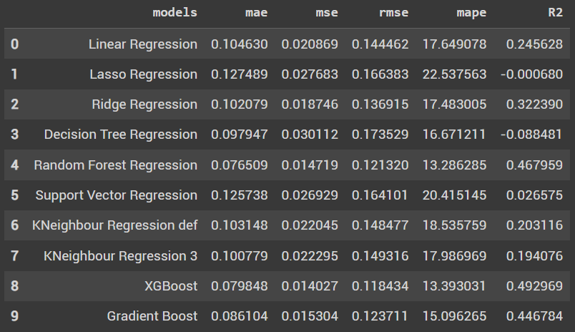

Slide 27

This research can be continued and advanced with a focus on imbalance and change to balance data. It would be applied with another Machin learning Algorithm, Natural neural Network and AI Technic.

Slide 28
Thank you for your Time

